Slide 1
Review for Network Layer
Oct 27

Slide 2
Topics we’ve covered
General view of network layer functions
IP protocol
IP address
NAT & IPv6
How to look up a routing table
How to build a routing table
SDN

Slide 3
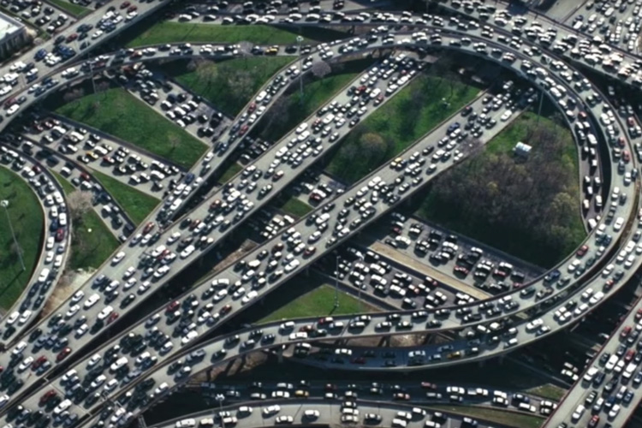
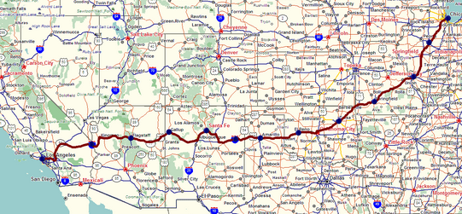
network layer functions
Routing: build the routing table (control plane)
Forwarding: lookup the routing table (data plane)
forwarding
routing

Slide 4
Design Principles for Internet
Make it work
Keep it simple (avoid features).
Expect heterogeneity.
Avoid static options and parameters.
Think about scalability.
Consider performance and cost (congestion control and optimization).
= IP protocol
Notes:
Remember network layer (not considering SDN) does not provide throughput or latency guarantees.
Remember: internet is largest distributed system develop by humans.

Slide 5
What Services do IP protocol provide?
End host to end host packet delivery
Some error detection (except for IPv6)
No guarantees for:
Bandwidth
Loss
Order
Timing
But works on:
Heterogenous network
Dynamic network topology
Decentralized network (too large to have a central controller)

Slide 6
IP Datagram format
32 bits
IP protocol version number
head.
len
type of
service
total datagram
length (bytes)
ver
length
header length(bytes)
“type” of service:
diffserv (0:5)
ECN (6:7)
flgs
fragment
offset
fragmentation/
reassembly
16-bit identifier
time to
live
upper
layer
header
checksum
header checksum
TTL: remaining max hops
(decremented at each router)
source IP address
32-bit source IP address
destination IP address
32-bit destination IP address
upper layer protocol (e.g., TCP or UDP)
overhead
options (if any)
e.g., timestamp, record route taken
20 bytes of TCP
20 bytes of IP
= 40 bytes + app layer overhead for TCP+IP
payload data
(variable length,
typically a TCP
or UDP segment)
Maximum length: 64K bytes
Typically: 1500 bytes or less
Notes:
Remember every time packet reaches a router, TTL is decremented. TTL provides protection against loops.
But also TTL always changes so checksum needs to constantly be recomputed at each router = extra overhead.

Slide 7
IPv6 datagram format
flow label: identify datagrams in same "flow.” (concept of “flow” not well defined).
32 bits
priority: identify priority among datagrams in flow
ver
pri
flow label
payload len
next hdr
hop limit
source address
(128 bits)
128-bit
IPv6 addresses
destination address
(128 bits)
payload (data)
What’s missing (compared with IPv4):
no checksum (to speed processing at routers)
no fragmentation/reassembly
no options (available as upper-layer, next-header protocol at router)

Slide 8
IPv4 vs. IPv6
1. IP address: 32 bits to 128 bits
2. IPv6 no longer support fragmentation, checksum
3. IPv6 add support for SDN
4.TTL (hop limit) remains.

Slide 9
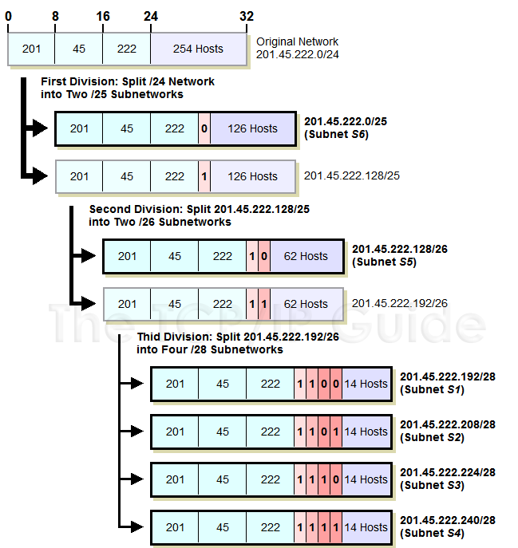
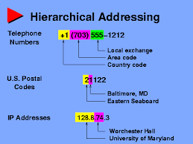
How IP addresses are distributed?
hierarchical addressing (nested subnetting):
Notes:
Easier to locate hosts using hierarchical structure.

Slide 10
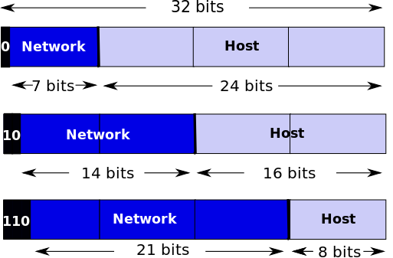
Classful Subnet
coarse-grained subnets: Class A, B, C IP Addresses
How Many available addresses in a type B/C subnet?
Rough answer: 2^16 -2 , 2^8 – 2
Broadcast address x.x.x.255
Network mask: x.x.x.0
two hosts need a class C address
Address assignment efficiency = 2/254 = 0.79%
256 hosts need a Class B address
Address assignment efficiency = 0.39%
Notes:
So how does the authority, IANA, divide the IP addresses into subnets? In the early days of Internet, nobody expects that one day we will have so many internet connected devices. So initially, the IP addresses are divided in a coarse-grained fashion, called the classful subnet.
While each subnet is assigned to an organization, the IANA is aware that different organizations may need different amount of IP addresses. So the subnets are divided into Class A, class B, class C, with each class having different amount of IP addresses. So class A uses the first 8 bits as network ID, and the last 24 bits as the host ID. Each class A subnet can have 2^24 IP addresses, and we have 2^7 class A subnets in total. So there are 127 class A subnet, with each of them supporting 16 million hosts. Class B subnets use the first 2 section of 8 bits as the network prefix, but the first two bits are fixed. So there are 16 thousands class B subnets, each support 65 thousand hosts. Class C subnets uses the first 24 bits as the network prefix, and the last 8 bits as host IDs. So a class C subnet can host up to 256 devices.
However, not all the IP addresses in a subnet can be used. When all the host bits are set to 0, it means the network mask. When all host bits are set to 1, the address is used for broadcast. So in my home network, the network id is 192.168.1.0, and the broadcast address is 192.168.1.255, these two IP addresses cannot be assigned to devices.
The problem of this classful subnet is that the utilization efficiency is low. For example, for a small company that only have two hosts, a class C subnet is required, which can host up to 254 hosts. For a company with 256 hosts, a class B address is needed. That makes the efficiency lower than 1%.

Slide 11
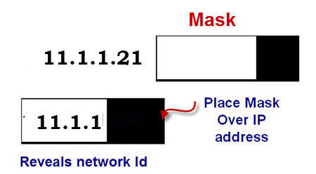
Network Mask
32-bit binary (example: 255.255.255.0)
apply AND operation bitwise on IP, filter subnet prefix
Examples:
192.168.1.134, subnet mask: 255.255.255.0, subnet address: 192.168.1.0
Class A: 255.0.0.0, Class B: 255.255.0.0, Class C: 255.255.255.0
Notes:
Just now we mentioned network mask. A network mask is like a mask, which covers the host ID part of an IP address, to reveal the network ID, or say the subnet prefix.
It is a 32 bit binary, just like an IP address. The bits for the network prefix are set to 1s, and the bits for the host ID are set to 0s. To find the network prefix, a network mask applies AND operation bitwise on an IP address, so that the subnet prefix is filtered out.
So the IP address of my desktop is 134, it is a class C subnet, and the subnet mask is 255.255.255.0. By applying the AND operation bitwise, we get the subnet address of 192.168.1.0
*apply AND operation of IP address AND mask and you will get the network ID to which the address belongs.

Slide 12
IP addressing: CIDR (much higher allocation efficiency than classful subnetting)
CIDR: Classless InterDomain Routing (pronounced “cider”)
subnet portion of address of arbitrary length
address format: a.b.c.d/x, where x is # bits in subnet portion of address
subnet
part
host
part
11001000 00010111 00010000 00000000
200.23.16.0/23

Slide 13

Not enough IPv4 addresses
NAT (network address translation)
all devices in local network share just one IPv4 address as far as outside world is concerned
rest of
Internet
local network (e.g., home network) 10.0.0/24
138.76.29.7
10.0.0.1
10.0.0.4
10.0.0.2
10.0.0.3
all datagrams leaving local network have same source NAT IP address: 138.76.29.7, but different source port numbers
datagrams with source or destination in this network have 10.0.0/24 address for source, destination (as usual)

Slide 14
NAT: network address translation
NAT translation table
WAN side addr LAN side addr
2: NAT router changes datagram source address from 10.0.0.1, 3345 to 138.76.29.7, 5001,
updates table
1: host 10.0.0.1 sends datagram to 128.119.40.186, 80
138.76.29.7, 5001 10.0.0.1, 3345
…… ……
S: 10.0.0.1, 3345
D: 128.119.40.186, 80
10.0.0.1
1
2
S: 138.76.29.7, 5001
D: 128.119.40.186, 80
10.0.0.4
10.0.0.2
138.76.29.7
S: 128.119.40.186, 80
D: 10.0.0.1, 3345
4
S: 128.119.40.186, 80
D: 138.76.29.7, 5001
3
10.0.0.3
3: reply arrives, destination address: 138.76.29.7, 5001
Notes:
Remember: NAT runs on local router to translate local source IP AND PORT to its public-side (WAN address) IP and a different PORT; it uses the NAT table it is maintain to map messages outbound and inbound so that local hosts can receive their respective messages.
probably source port as well because of limited number of ports just as there are IP addresses → so router will give their host a public IP and PORT and maintain mapping so that the local host that has a private IP address can communicate with outside world using the WAN address and a WAN port sources.

Slide 15
Tunneling
A
B
IPv4 tunnel
connecting IPv6 routers
E
F
logical view:
IPv6
IPv6/v4
IPv6/v4
IPv6
A
B
C
D
E
F
physical view:
IPv6
IPv6/v4
IPv4
IPv4
IPv6/v4
IPv6
flow: X
src: A
dest: F
data
src:B
dest: E
src:B
dest: E
src:B
dest: E
flow: X
src: A
dest: F
data
Flow: X
Src: A
Dest: F
data
Flow: X
Src: A
Dest: F
data
Flow: X
Src: A
Dest: F
data
Note source and destination addresses!
A-to-B:
IPv6
B-to-C:
IPv6 inside
IPv4
B-to-C:
IPv6 inside
IPv4
B-to-C:
IPv6 inside
IPv4
E-to-F:
IPv6

Slide 16
How to lookup a routing table
Given an IP address and a routing table:
Q1: does the given IP match multiple table entries?
No: find the only matching entry
Yes, then Q2
Q2: which is the longest address prefix that matches the given IP?
Longest Prefix Match: when looking for forwarding table entry for given destination address, use longest address prefix that matches destination address.

Slide 17
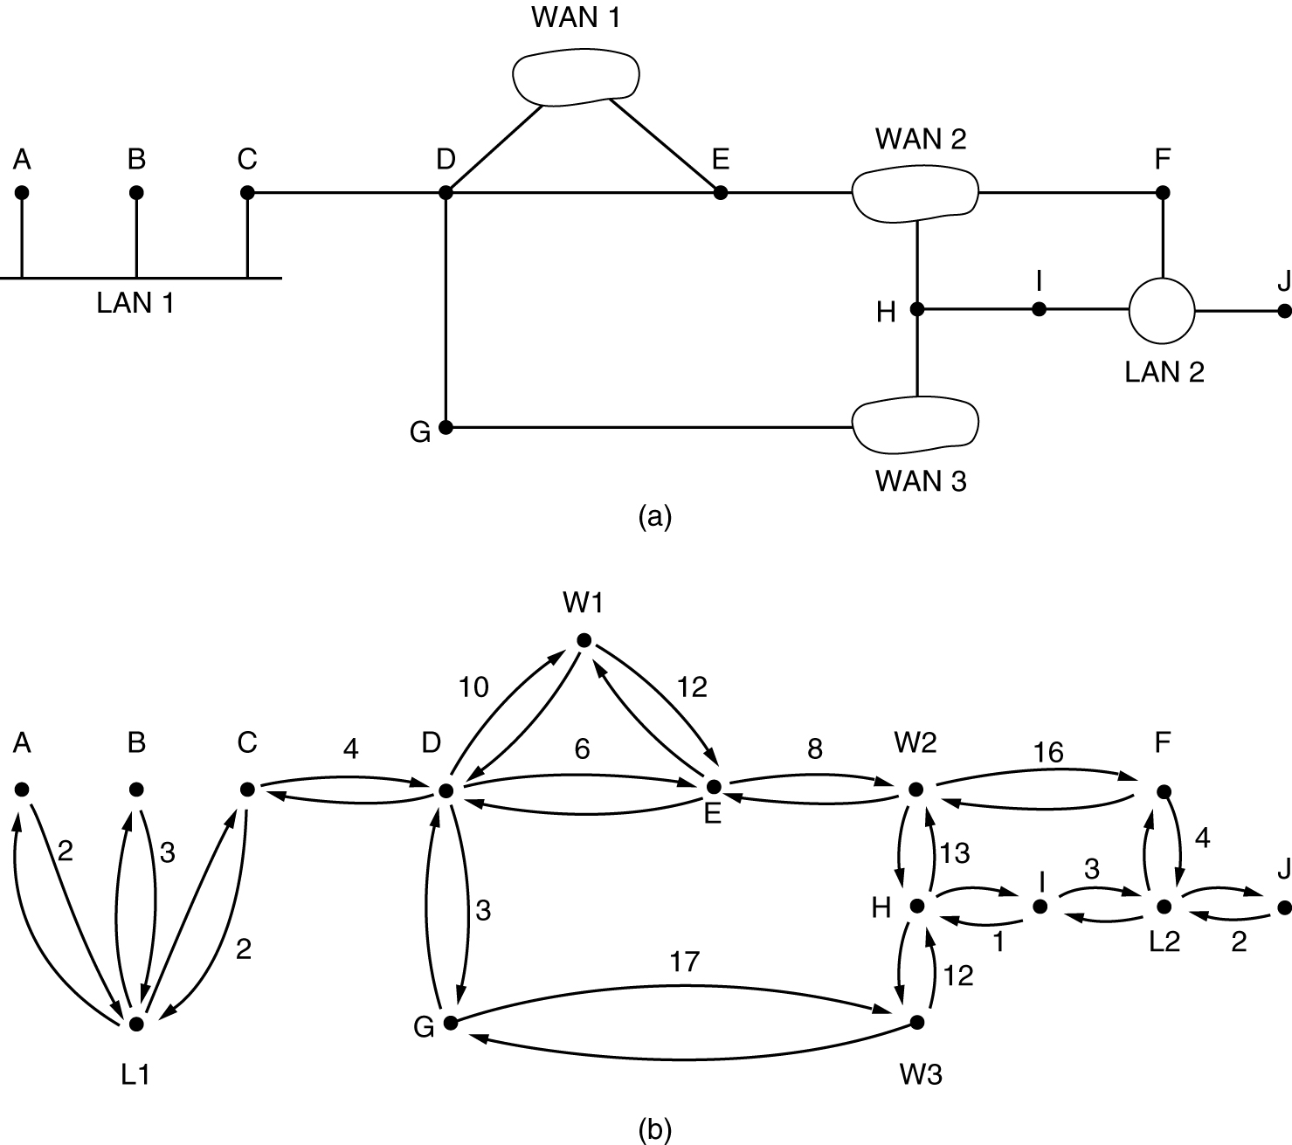
How to build a routing table
Graph: node, link, cost
Cost:
Hops,
latency
1/bandwidth
congestion level

Slide 18
Basic idea
Link state: tell the world about your neighbors
Dijkstra’s algorithm: build a shortest path tree
Distance vector : tell your neighbors about the world
Bellman ford equation: through which neighbor should I reach a destination node? (compares the cost of going through which neighbor to reach another node and adds that cost to the cost of traveling to a given neighbor itself)
Cost to neighbor + cost to get to a node through that neighbor (as advertised by that neighbor)

Slide 19
Dijkstra’s algorithm (aka OSPF = Link State type of algorithm): another example
v
w
x
y
z
x
D(v),
p(v)
D(w),
p(w)
D(x),
p(x)
D(y),
p(y)
D(z),
p(z)
9
Step
N'
0
u
7,u
3,u
5,u
∞
∞
5
7
4
1
uw
6,w
5,u
11,w
∞
8
2
uwx
6,w
11,w
14,x
u
3
w
y
z
2
3
uwxv
10,v
14,x
3
4
uwxvy
12,y
7
4
5
uwxvyz
v
notes:
construct least-cost-path tree by tracing predecessor nodes
ties can exist (can be broken arbitrarily)

Slide 20
Bellman-Ford Example
Suppose that u’s neighboring nodes, x,v,w, know that for destination z:
D_{v}(z) = 5
D_{w}(z) = 3
Bellman-Ford equation says:
5
D_{u}(z) = min { c_{u,v} + D_{v}(z),
c_{u,x} + D_{x}(z),
c_{u,w} + D_{w}(z) }
v
3
w
2
5
u
2
1
z
3
= min {2 + 5,
1 + 3,
5 + 3} = 4
1
2
x
y
1
D_{x}(z) = 3
node achieving minimum (x) is next hop on estimated least-cost path to destination (z)

Slide 21
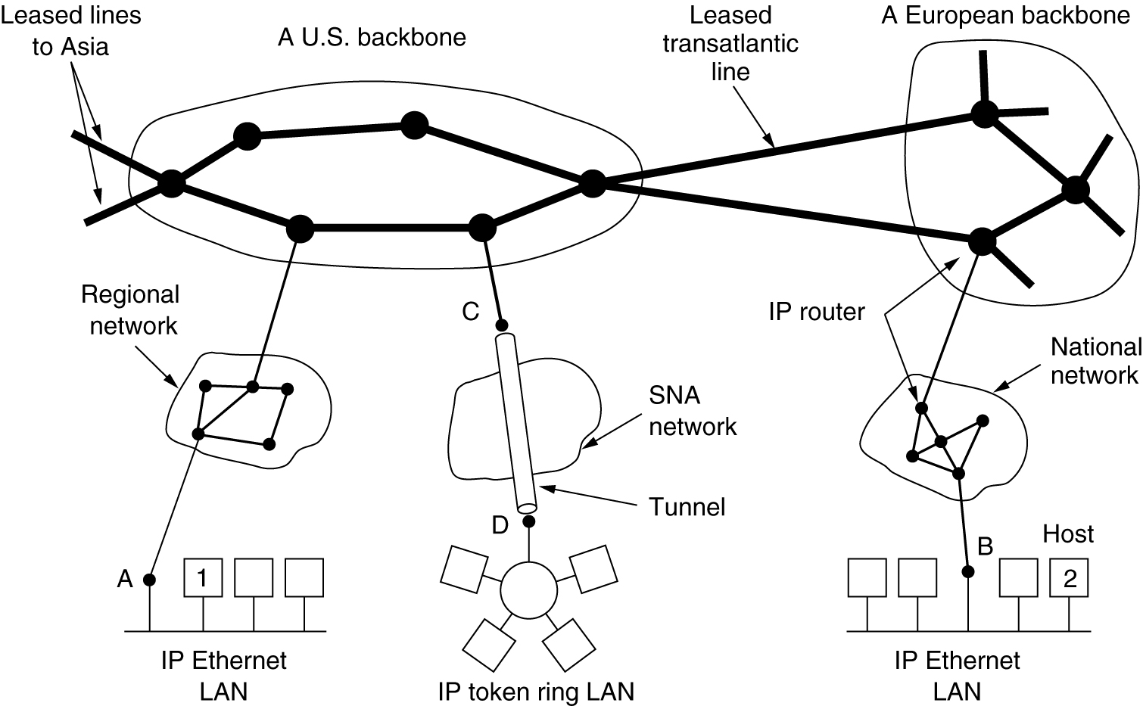
In real life
Internet: Autonomous systems (network of networks)

Slide 22
Intra and inter AS routing (AS is another way of just saying “a network/subnet”
Intra: OSPF: build the path for each router to reach other routers within the same autonomous system (link state)
Inter: BGP: obtain subnet reachability information from neighboring ASes (eBGP), and propagate reachability information to all AS-internal routers (iBGP)

Slide 23
BGP path advertisement
AS 3
3b
AS 1
1b
AS3,X
3a
3c
1
AS3,X
1a
AS3,X
1c
AS 2
2b
3d
X
local link interfaces
at 1a, 1d
2
AS3,X
2
1d
1
AS3, X
AS2,AS3,X
2a
2c
2d
dest
interface
recall: 1a, 1b, 1d learn via iBGP from 1c: “path to X goes through 1c”
…
…
at 1d: OSPF intra-domain routing: to get to 1c, use interface 1
1c
1
X
1
at 1d: to get to X, use interface 1
…
…
at 1a: OSPF intra-domain routing: to get to 1c, use interface 2
at 1a: to get to X, use interface 2

Slide 24
Software defined networking (SDN)
…
3. control plane functions external to data-plane switches
4. programmable control applications
routing
access control
load
balance
Remote Controller
control
plane
data
plane
CA
2. control, data plane separation
CA
CA
CA
CA
1: generalized “flow-based” forwarding (e.g., OpenFlow)
Notes:
SDN is the future
ISP are already testing and using SDAN == software defined access networks.
Load balancing = SDN application
As well as routing and access control…etc. as shown above.
Remember SDN manages the hardware of multiple machines (particularly, routers).

Slide 25
Software defined networking (SDN)
Data-plane switches:
fast, simple, commodity switches implementing generalized data-plane forwarding (Section 4.4) in hardware
flow (forwarding) table computed, installed under controller supervision
API for table-based switch control (e.g., OpenFlow)
defines what is controllable, what is not
protocol for communicating with controller (e.g., OpenFlow)
network-control applications
…
routing
access
control
load
balance
control
plane
northbound API
SDN Controller
(network operating system)
southbound API
data
plane
SDN-controlled switches

Slide 26
Flow table abstraction
flow: defined by header fields
generalized forwarding: simple packet-handling rules (match plus action)
match: pattern values in packet header fields
actions: for matched packet: drop, forward, modify, matched packet or send matched packet to controller
priority: disambiguate overlapping patterns
counters: #bytes and #packets
src = *.*.*.*, dest=3.4.*.* forward(2)
Flow table
match
action
src=1.2.*.*, dest=*.*.*.* drop
src=10.1.2.3, dest=*.*.*.* send to controller
* : wildcard
1
4
3
2

Slide 27
Software defined networking (SDN)
SDN controller (network OS):
maintain network state information
interacts with network control applications “above” via northbound API
interacts with network switches “below” via southbound API
implemented as distributed system for performance, scalability, fault-tolerance, robustness
network-control applications
…
routing
access
control
load
balance
control
plane
northbound API
SDN Controller
(network operating system)
southbound API
data
plane
SDN-controlled switches

Slide 28

OpenFlow: controller-to-switch messages
Key controller-to-switch messages
features: controller queries switch features, switch replies
configure: controller queries/sets switch configuration parameters
modify-state: add, delete, modify flow entries in the OpenFlow tables
packet-out: controller can send this packet out of specific switch port
OpenFlow Controller
Notes:
So apparently all of the overhead of SDN is still more efficient than the overhead from just letting each router to run protocols to build routing tables and forward packets.

Slide 29
Software defined networking (SDN)
network-control apps:
“brains” of control: implement control functions using lower-level services, API provided by SDN controller
unbundled: can be provided by 3rd party: distinct from routing vendor, or SDN controller
network-control applications
…
routing
access
control
load
balance
control
plane
northbound API
SDN Controller
(network operating system)
southbound API
data
plane
SDN-controlled switches

Slide 30
SDN in real life
Google B4 SDN:
2013 SIGCOMM B4: experience with a globally deployed software defined WAN
2015 ATC: https://www.usenix.org/sites/default/files/conference/protected-files/atc15_slides_mandal.pdf
2021 NSDI: Orion: Google's {Software-Defined} Networking Control Plane

Slide 31
Convergence of Link state v Distance vector algorithms
NOTE: for OSPF (link state algorithm), the overhead of space complexity O(N^2) depends on the number of messages that need to be sent so that the network “converges” or is in agreement on what the best paths are.
For Distance Vector, convergence depends on number of iterations (bellman updates) with time complexity of O(NlogN)

Slide 32
Special Note about Link Layer (which uses 48-bit MAC ADDRESSING)
The physical ports/network cards/antennas cannot physically block electricity that is being sent to them by other devices unless they are physically turned off, at which point they cannot communicate. Thus, it is not a logical address because the MAC address on the interface card is a physical circuit address that is immutable by software logic on the port (defined by the other non-port hardware on which the OS runs and specifies the logical addressing) and must accept and send messages in accordance with it hardware logic on the port.
When devices “don’t share” their immutable hardware MAC address by using a spoofed/changed MAC address, then that MAC address is a logical address just like IP addresses are because they can be changed. If an address is changeable, then it is a logical (SOFTWARE) address defined by other (non-port/non-interface) hardware which is running the OS software which runs other software and defines the logical (changeable) address.

